Slide 1
Language Translator
Compiler:
Compiler has many Phases and Passes.
Pass: It is traversal of a compiler through the entire program.
Phase: It is a distinguishable stage, which takes input from the previous stage, processes and yields output that can be used as input for next stage.

Slide 2
The phases of a compiler
Source program
Lexical Analysis
Syntax Analysis
Symbol
table
Semantic Analysis
Error
handler
Intermediate code generation
Code optimization
Code generation
Target program

Slide 3
Int a, b;
/* */
a=b+5;/*addition*/
I
n
T
Int
A
,
B
;
Sym no | Sym name | type
1 | a | Int
2 | b | int

Slide 4
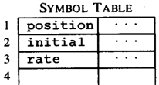




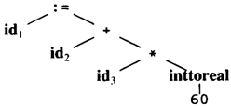
The Structure of a Compiler (8)
Code Generator
[Intermediate Code Generator]
Non-optimized Intermediate Code
Scanner [Lexical Analyzer]
Tokens
Code Optimizer
Parser [Syntax Analyzer]
Optimized Intermediate Code
Parse tree
Code Optimizer
Semantic Process [Semantic analyzer]
Target machine code
Abstract Syntax Tree w/ Attributes

Slide 5
Example
R3=R1+R2*R3;
CFG
S->id=E;
E->E+T/T
T->T*F/F
F->id
Int a, b,c;
a=b+c;
Smb no | Sym name | type
1 | a | int
2 | b | Int
3 | c | int

Slide 6
Lexical Analysis
first phase of scanner works as a text scanner
This phase scans the source code as a stream of characters and converts it into meaningful lexemes
Lexical analyzer represents these lexemes in the form of tokens
A token is a set of characters that does not have 'space', 'tab' and 'new line'
It is also called "TOKENIZER“
It also removes the comments, generates symbol table and relocation table entries

Slide 7
Syntax Analysis or parsing
It takes the token produced by lexical analysis as input and generates a parse tree (or syntax tree)
In this phase, token arrangements are checked against the source code grammar, i.e. the parser checks if the expression made by the tokens is syntactically correct

Slide 8
Syntactic Analyzer:
This unit check for the syntax in the code. For ex:
{
int a; int b; int c; int d;
d = a + b - c * ;
}
This unit checks this internally by generating the parse tree

Slide 9
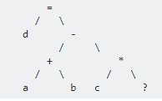
Parse Tree Therefore this unit is also called PARSER

Slide 10
Semantic Analysis
Semantic analysis checks whether the parse tree constructed follows the rules of language e.g assignment of values is between compatible data types, and adding string to an integer
Also, the semantic analyzer keeps track of identifiers, their types and expressions;
whether identifiers are declared before use or not etc.
The semantic analyzer produces an annotated syntax tree as an output.

Slide 11
Semantic Analyzer:
This unit checks the meaning in the statements. For ex
{
Int i;
Int *p;
P=i;
}
The above code generates the error “Assignment of incompatible type”

Slide 12
Intermediate Code Generation
It represents a program for some abstract machine
It is in between the high-level language and the machine language
This intermediate code should be generated in such a way that it makes it easier to be translated into the target machine code.

Slide 13
Code Optimization
The next phase does code optimization of the intermediate code
Optimization can be assumed as something that removes unnecessary code lines, and arranges the sequence of statements in order to speed up the program execution without wasting resources (CPU, memory)

Slide 14
Code Optimization
This unit optimizes the code in following forms:
I) Dead code elimination
II) Sub code elimination
III) Loop optimization

Slide 15
Dead code elimination:
{
Int a= 10;
If(a>5)
{…..}
Else
{
}
compiler knows the value of 'a' at compile time, therefore it also knows that the if condition is always true. Hence it eliminates the else part in the code

Slide 16
Sub code elimination:
Int a, b, c;
Int x,y;
{
int a, b, c; int x, y;
/* ... */
x = a + b;
y = a + b + c;
/* ... */
}

Slide 17
{
int a, b, c;
int x, y;
/* ... */
x = a + b;
y = x + c; // a + b is replaced by x
/* ... */
}

Slide 18
Loop optimization:
For ex:
{ int a;
for (i = 0; i < 1000; i++ )
{ /* ... */
a = 10;
/* ... */
} }

Slide 19
Code Generation
It takes the optimized representation of the intermediate code and maps it to the target machine language
It translates the intermediate code into a sequence of (generally) re-locatable machine code
Sequence of instructions of machine code performs the task as the intermediate code would do

Slide 20
Symbol Table
It is a data-structure maintained throughout all the phases of a compiler
All the identifier's names along with their types are stored here
The symbol table makes it easier for the compiler to quickly search the identifier record and retrieve it
The symbol table is also used for scope management

Slide 21
Interaction of Lexical analyzer with parser
token
Source
program
Lexical
analyzer
parser
getNexttoken()
symbol
table

Slide 22
Some terminology:
Token: a group of characters having a collective meaning. A lexeme is a particular instant of a token.
E.g. token: identifier, lexeme: pi, etc.
pattern: the rule describing how a token can be formed.
E.g: identifier: ([a-z]|[A-Z]) ([a-z]|[A-Z]|[0-9])*
Lexical analyzer does not have to be an individual phase.
But having a separate phase simplifies the design and improves the efficiency and portability.

Slide 23
Specification of tokens
In theory of compilation regular expressions are used to formalize the specification of tokens
Regular expressions are means for specifying regular languages
Example:
Letter_(letter_ | digit)*
Each regular expression is a pattern specifying the form of strings

Slide 24
Regular expressions
Ɛ is a regular expression, L(Ɛ) = {Ɛ}
If a is a symbol in ∑then a is a regular expression, L(a) = {a}
(r) | (s) is a regular expression denoting the language L(r) ∪ L(s)
(r)(s) is a regular expression denoting the language L(r)L(s)
(r)* is a regular expression denoting (L(r))*
(r) is a regular expression denting L(r)

Slide 25
Automatic construction of lexical analyzer using LEX Lex
generates C code for the lexical analyzer (scanner)
Token patterns specified by regular expressions

Slide 26
Lex
lex.yy.c
Lex Source file → Lex compiler→
C compiler→ a.out
Input stream → Scanner→ Sequence of tokens

Slide 27
Lexical Analyzer Generator - Lex
Lex Source program
lex.l
Lexical Compiler
lex.yy.c
C
compiler
lex.yy.c
a.out
a.out
Sequence of tokens
Input stream

Slide 28
Lex program structure
… definitions …
%%
… rules …
%%
… subroutines …

Slide 29
Three parts to Lex
Declarations
It has global C and Lex declaration
Regular expression definitions of tokens
%{ This is a sample Lex program written by....%}
digit --> [0-9]
number -- > {digit} +
2. Transition Rules
pattern
Regular Expression +Action when matched
{number} { printf("The number is %s\n", yytext); }
junk { printf("Junk is not a valid input!\n"); }
quit { return 0; }
3. Auxilliary Procedures
Written into the C program…..
int main() is required
%% separates the three parts

Slide 30
LEX program
%{/*recognition of Verb*/%}
%%
[/t ]+ ;
is I am I are I were I was I be {printf("%s: is a verb\nn, yytext); }
[a-zA-Z]+ {printf(“%s:is not a verb\n”, yytext);}
%%
Main()
{
yylex();
}

Slide 31
Example
% {
% }
delim [ \t\n]
ws {delim}+
letter [A-Za-z]
digit [0-9]
id {letter}({letter}|{digit})*
number {digit}+(\.{digit}+)?(E[+\-]?{digit}+)?
%%
{ws} { /* no action and no return */ }
if {return(IF);}
then {return(THEN);}
else {return(ELSE);}
{id} {yylval = install_id(); return(ID);}
{number} {yylval = install_num();return(NUMBER);}
…
%%

Slide 32
Available variables
Yylval –value associated with token
yytext (null terminated string)
yyleng (length of the matching string)
yyin : the file handle
yyin = fopen(args[0], “r”)
Available functions
yylex() (the primary function generated)-starts the analysis
input() - Returns the next character from the input
int main(int argc, char *argv[])
Calls yylex to perform the lexical analysis
Int yywrap(void) wrapup, return 1 if done, 0 if not done

Slide 33
Regular Expression in Lex
A- matches A
abc –matches abc
[abc]- matches a, b or c
[0-9] - matches any digit
[0-9]+ - matches any integer

Slide 34
How to Use Lex (flex)
Run Unix “man flex” for full information
Write regular expressions and actions
Compile using Lex (flex) tool
flex <prog_name>.l
Results in C code
Compile using C compiler
Link to the lex library
gcc lex.yy.c
Run the a.out file and recognize tokens
a.out < input.text>

Slide 35
Lexer generators
The power
Programmer describes tokens as regular expressions
Lex turns description of tokens into code
Generated code compiles into a scanner
The pitfalls
Source code generated by lex hard to debug
Without understanding basis in formal languages, lex can be a quirky black box

Slide 36
Pattern Matching and Action
Match a character
in the a-z range
Buffer
[a-z] { c = yytext[0]; yylval = c - 'a'; return(LETTER); }
[0-9]+ { yylval = atoi(yytext); return(NUMBER); }
Place the offset c – ‘a’
In the stack
Match a positive integer
(sequence of 0-9 digits)
Place the integer value
In the stack

Slide 37
Recognition of tokens
Starting point is the language grammar to understand the tokens:
stmt -> if expr then stmt
| if expr then stmt else stmt
| Ɛ
expr -> term relop term
| term
term -> id
| number

Slide 38
Recognition of tokens (cont.)
The next step is to formalize the patterns:
digit -> [0-9]
Digits -> digit+
number -> digit(.digits)? (E[+-]? Digit)?
letter -> [A-Za-z_]
id -> letter (letter|digit)*
If -> if
Then -> then
Else -> else
Relop -> < | > | <= | >= | = | <>
We also need to handle whitespaces:
ws -> (blank | tab | newline)+

Slide 39
Error detection and Recovery in Compiler
Functions of Error handler
Detection
Reporting
Recovery

Slide 40
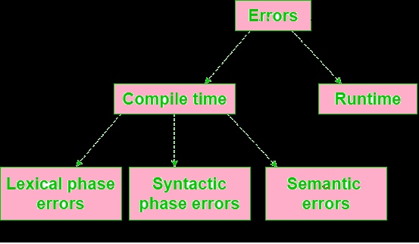

Slide 41
Lexical phase errors
are detected during the lexical analysis phase
Example of lexical errors
Exceeding length of identifier or numeric constants.
Appearance of illegal characters
Unmatched string
-printf(“hello”);r
-/*lex Error
Printf(“hello”);

Slide 42
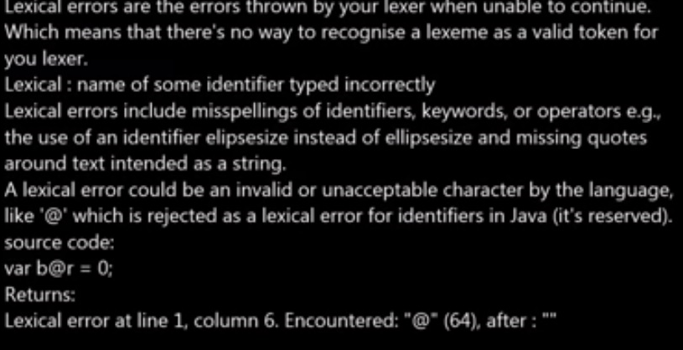
Lexical Errors

Slide 43
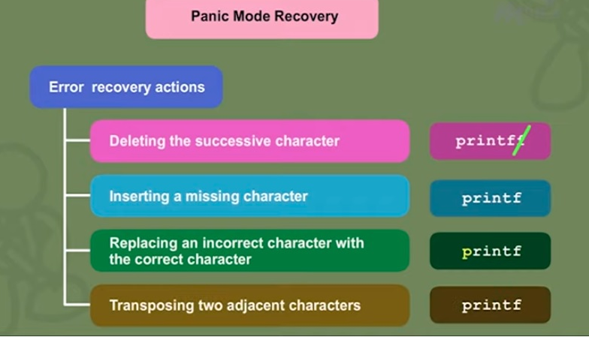
Error recovery : Error handling in Lex

Slide 44
Error recovery : Error handling in Lex
Panic mode: Successive characters are ignored until we reach a well formed token
e.g.{jkjkj}
-Delete one character from the remaining input
e.g. ;scv
Valid token scv
-Insert a missing character into the remaining input
e.gprntf-printf
-Replace a character by another character
e.g. whele-while
-Transpose 2 adjacent characters
e.g. fi-if

Slide 45
Syntactic phase errors
detected during syntax analysis phase

Slide 46
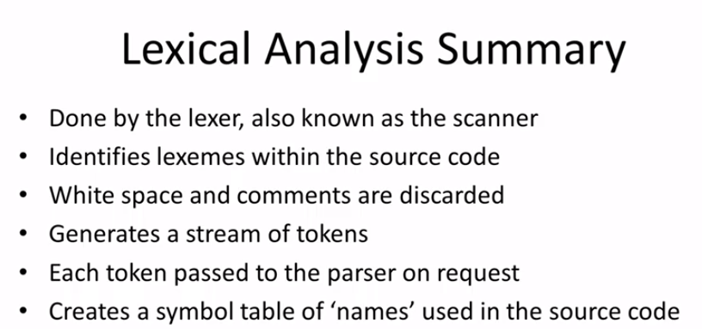

Slide 47
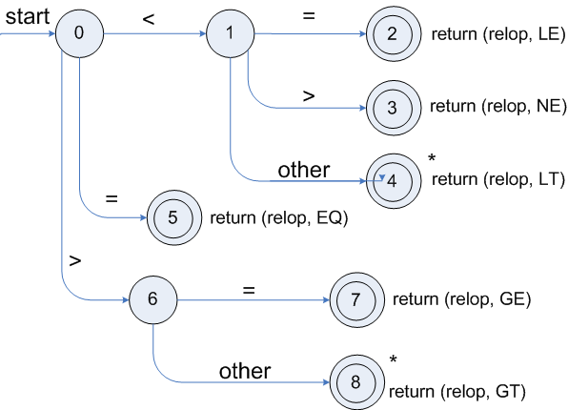
Transition diagrams
Transition diagram for relop

Slide 48
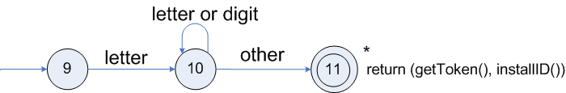
Transition diagrams (cont.)
Transition diagram for reserved words and identifiers

Slide 49
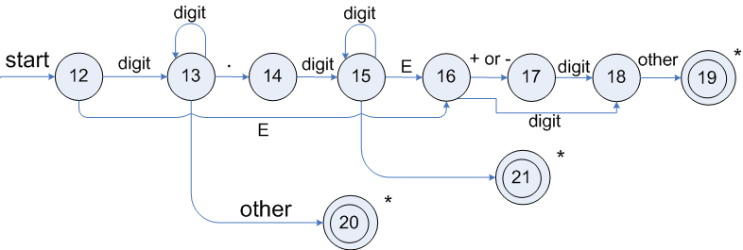
Transition diagrams (cont.)
Transition diagram for unsigned numbers

Slide 50
Multiple choice questions
The number of tokens in the following C statement is
printf("i = %d, &i = %x", i, &i);
(A) 3 printf ( “” , i , & i ) ;---total 10 tokens
(B) 26 (C) 10 (D) 21
Answer: c

Slide 51
The lexical analysis for a modern computer language such as Java needs the power of which one of the following machine models in a necessary and sufficient sense?
(A) Finite state automata (B) Deterministic pushdown automata (C) Non-Deterministic pushdown automata (D) Turing Machine
Answer: B

Slide 52
In a compiler, keywords of a language are recognized during
(A) parsing of the program (B) the code generation (C) the lexical analysis of the program (D) dataflow analysis
Answer: C

Slide 53
Consider the following statements:
(I) The output of a lexical analyzer is groups of characters.
(II) Total number of tokens in printf("i=%d, &i=%x", i, &i); are 11.
(III) Symbol table can be implementation by using array and hash table but not tree.
Which of the following statement(s) is/are correct? (A) Only (I) (B) Only (II) and (III) (C) All (I), (II), and (III) (D) None of these
Answer: D

Slide 54
The number of tokens in the following C statement is printf(“i=%d, &i=%x”, i&i); (A) 13 (B) 6 (C) 10 (D) 9
Answer: D

Slide 55
Consider the following statements related to compiler construction :
I. Lexical Analysis is specified by context-free grammars and implemented by pushdown automata. II. Syntax Analysis is specified by regular expressions and implemented by finite-state machine.
Which of the above statement(s) is/are correct ? (A) Only I (B) Only II (C) Both I and II (D) Neither I nor II
Answer :D

Slide 56
What is the output of a lexical analyzer?
a) Machine Code b) Intermediate Code c) Stream of Token d) Parse Tree
Answer: c

Slide 57
In a compiler the module that checks every character of the source text is called __________ a) The code generator b) The code optimizer c) The lexical analyzer d) The syntax analyzer
Answer c

Slide 58
Which one is a type of Lexeme? a) Identifiers b) Constants c) Keywords d) All of the mentioned
Answer d

